Slide 1
Intro to Deep learning
Session – 02: Convolutional Neural Networks
Instructor: Diego Corona
The University of Manchester

Slide 2
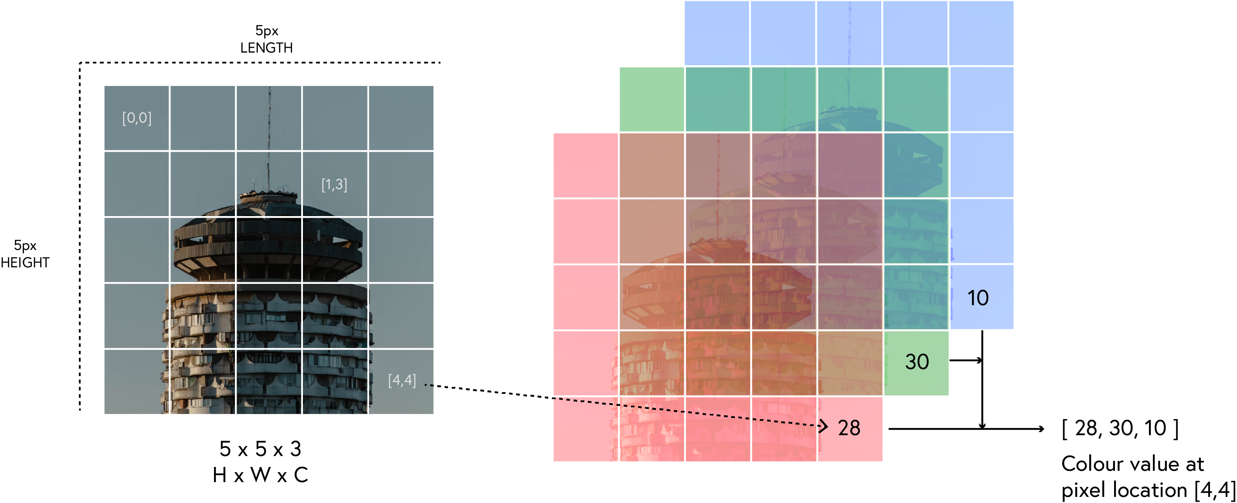
ANN

Slide 3
